Slide 1
Decision Models for Habitat Restoration
David Tomberlin (NMFS / Santa Cruz)
with
Teresa Ish (UC Santa Cruz)
Jongbum Kim (USGS)
Jesse O’Hanley (Oxford U.)
Matt Thompson (Oregon State U.)
January 18, 2006

Slide 2
Overview
Decision Models
Pacific Salmon Context
Watershed Mgt / Competing Objectives / MIP
Passage Removal / Spatial Relations / NLIP
Erosion Control / Project Timing / MDP
Erosion Control / Monitoring / POMDP

Slide 3
Decision Models
Ingredients
  decision variables
  objective function
  constraints
Examples
  classical optimization
  Markov decision (‘adaptive mgt’)
  Bayesian
  fuzzy control, robust optimization, etc.

Slide 4
Decision Models: Why Bother?
Identify desirable actions
Assess trade-offs
Identify research needs
Focus discussion among stakeholders

Slide 5
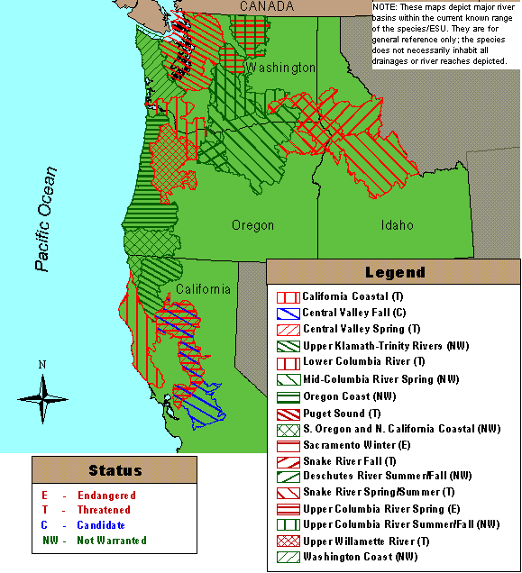
Salmonid Habitat Restoration
ESA Listings (27 ESUs)
> $110 mn on habitat restoration (2001) in CA
Threats to freshwater salmon habitat
  Sediment
  Passage barriers
  Temperature
  Water diversion,
  mining, etc.

Slide 6
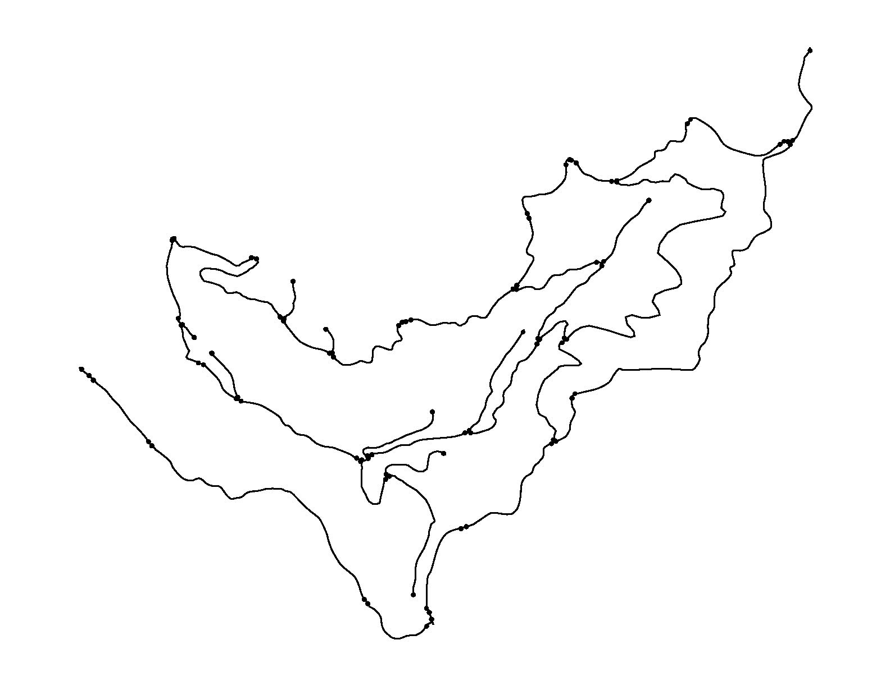
Model 1: MIP (Spatial + Deterministic + Myopically Dynamic)
Question 1: What are the tradeoffs between erosion control and timber production in a watershed? What’s the best mix?

Slide 7
Model 1: A Mixed-Integer Program
Goal: Max net benefit
Benefits: Timber and access
Costs: Logging, transport, and erosion control
Constraints:
  Max erosion
  Access and traffic flow
  Inter-temporal

Slide 8
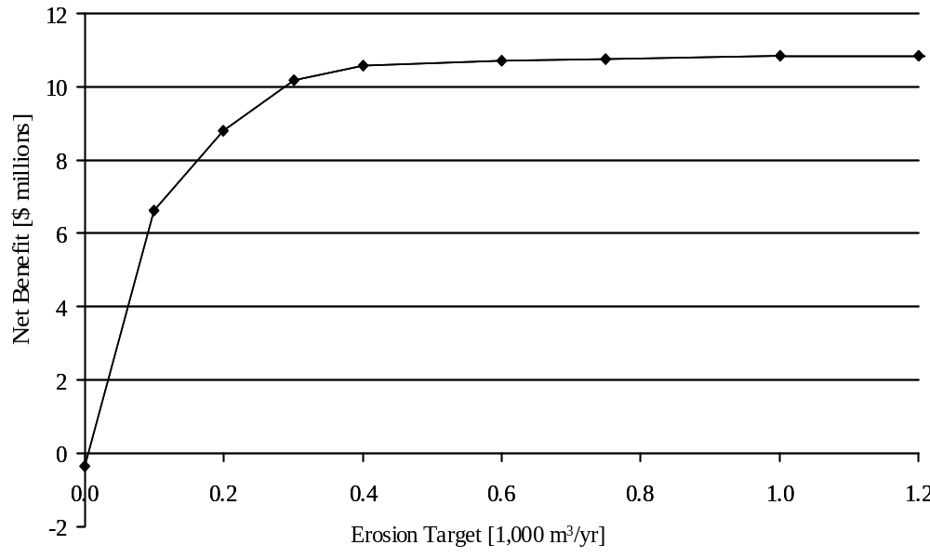
Model 1: Results

Slide 9
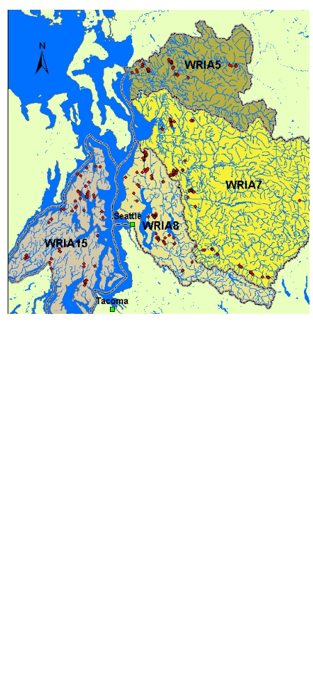
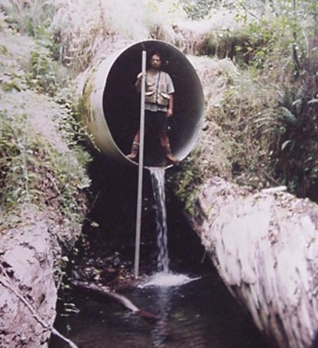
Model 2: NLIP (Spatial + Deterministic)
Question 2: Which fish passage barriers should be removed with a given budget?

Slide 10
Model 2: NLIP
Goal: maximize the increase in upstream accessibility, subject to a budget constraint.
max z = ∑_{j}v_{j} [ ∏_{k} (p_{k}º + ∑_{i}p_{ik}x_{ik})- ∏_{k} p_{k}º ] (sum of increases in passability-weighted stream length)
subject to
∑_{i}x_{ij} ≤ 1 ∀ j (only one project can be chosen)
∑_{j}∑_{i}c_{ij}x_{ij} ≤ b (only $b can be spent in total)
x_{ij} ∈ {0,1} ∀ i (projects are all-or-nothing)
where
i = project index
j = barrier index
k = barrier index for barriers downstream of j (and including j)
v = habitat above barrier j until next upstream barrier
p = percent passability index for each barrier
x = project variable (do or don’t)
c = project cost
b = total budget

Slide 11
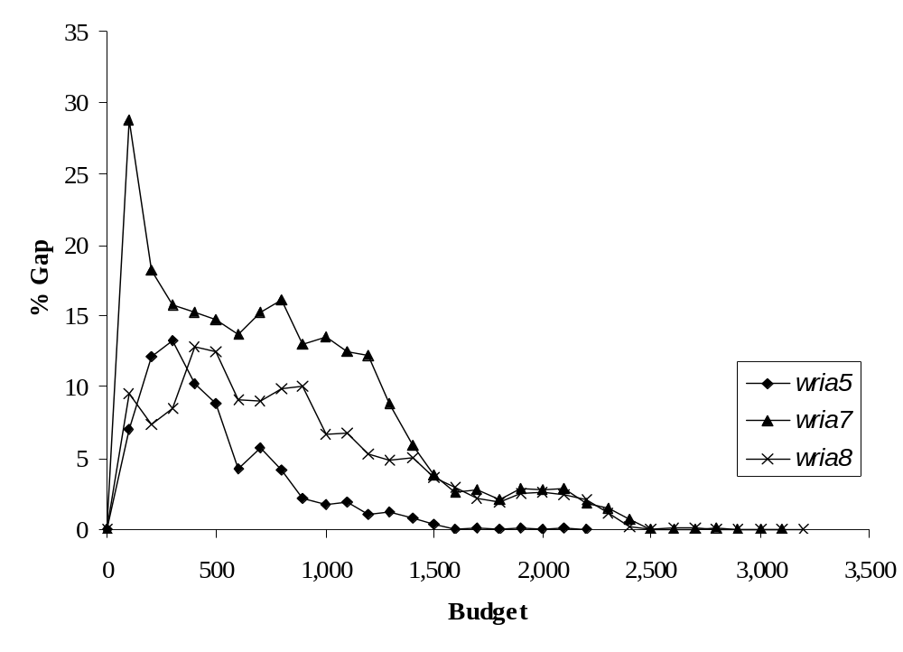
Model 2: Results
Percent deviation from optimum of a sorting and ranking procedure
for three watersheds in western Washington, as a function of budget.

Slide 12
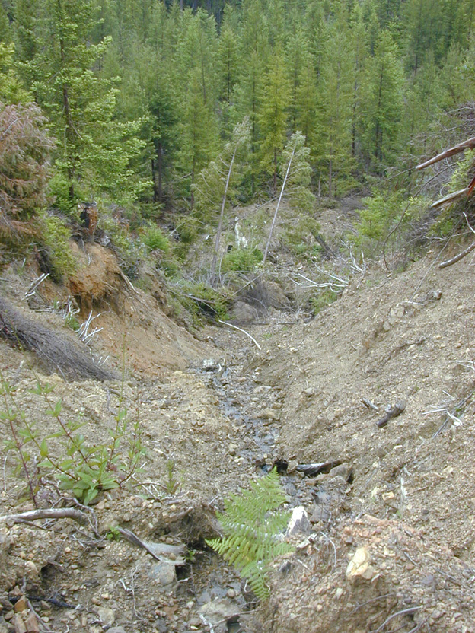
Model 3: Markov Decision Process
(Stochastic + Dynamic)
→ ‘Adaptive Mgt’
Question 3: What’s the best way to control logging road erosion under uncertainty?

Slide 13
Model 3: Problem Characteristics
Possible treatments:
  Maintain status quo road (cheap, high-risk)
  Upgrade road (moderate expense and risk)
  Remove road (expensive, low-risk)
State variables:
  Landslide volume
  Surface erosion volume
  Crossing-failure volume

Slide 14
Model 3: SDP Representation
where V(x) = the expected present and future cost of optimal treatment
x = vector of erosion volumes
u = control
C₁(x) = annual road maintenance costs for status quo road
C₂(x) = annual road maintenance costs for upgraded road
ρ = manager’s discount rate
s = 2 if the road has already been upgraded
1 if the road is still status quo
U = lump-sum cost of road upgrade
R₁ = lump-sum cost of status quo road removal
R₂ = lump-sum cost of upgraded road removal

Slide 15
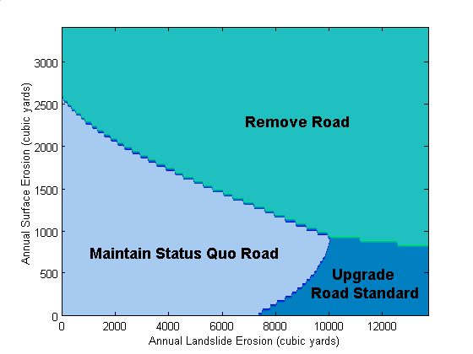
Model 3: Results

Slide 16
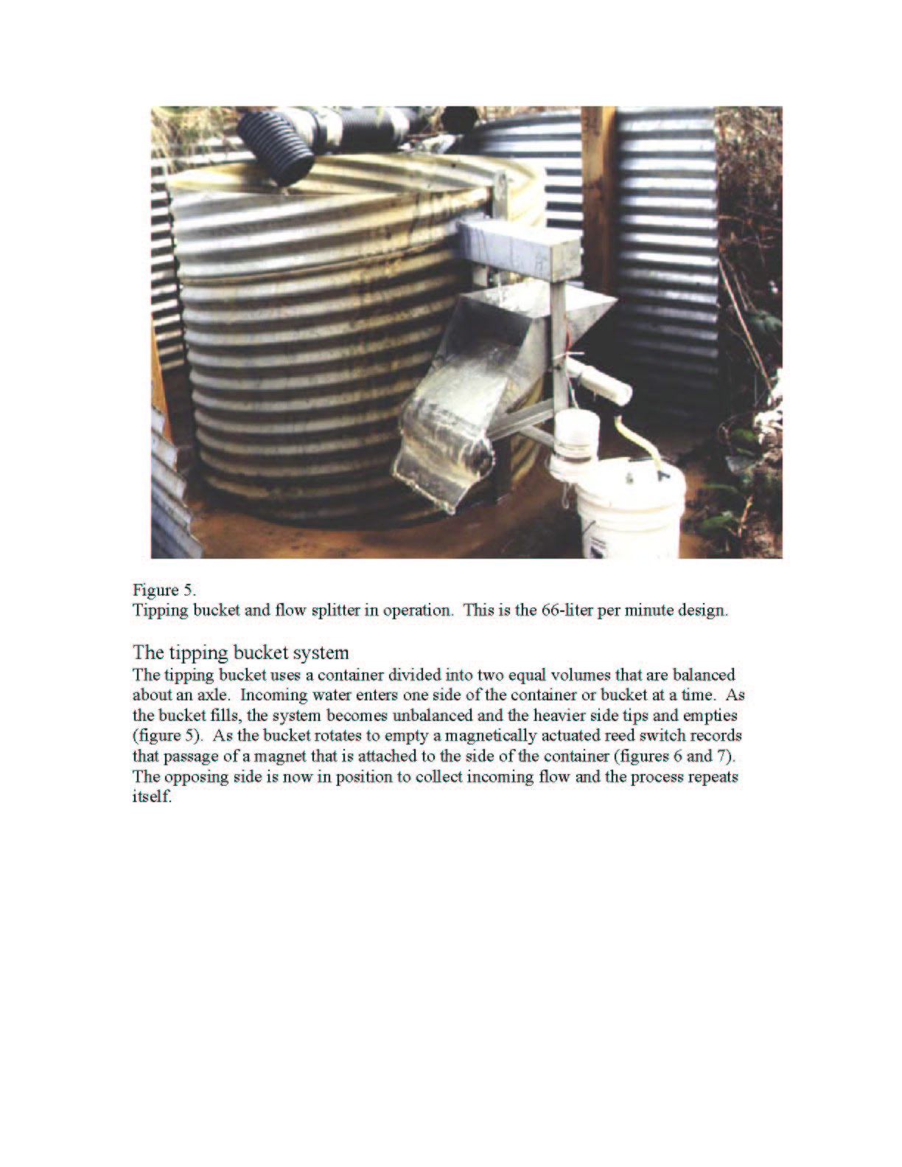
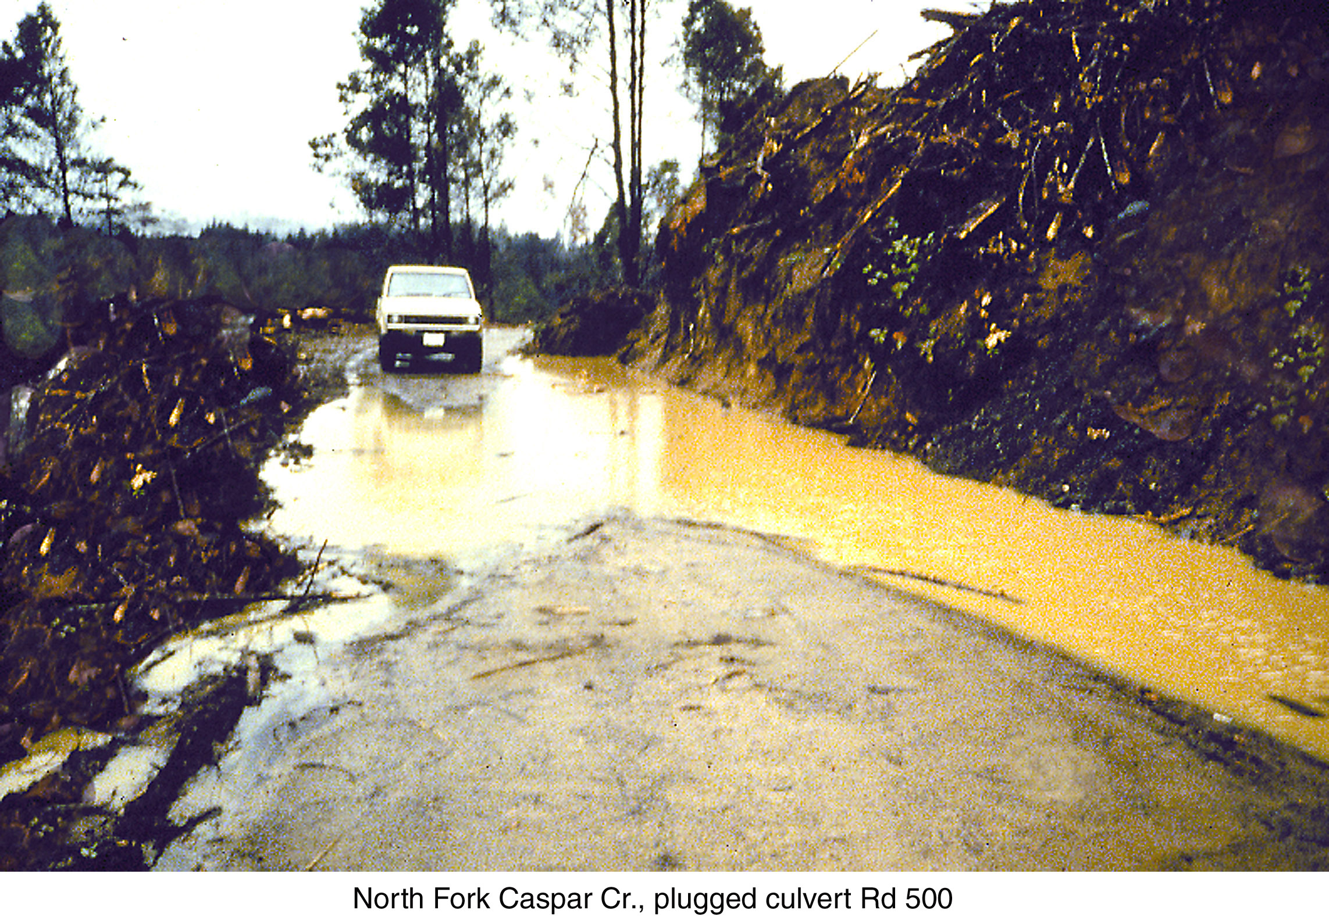
(Question 4b: In general, what is the best mix of learning and doing?)
Model 4: POMDP (Stochastic + Dynamic + Noisy)
Question 4: When is it worth the trouble to learn how much erosion we have?

Slide 17
POMDP Generalities
MDP = {S, P, A, W}
POMDP = {S, P, Θ, R, A, W}
MDP maps state → action
POMDP maps beliefs → action
Unknown state variables,
known parameters*

Slide 18
POMDP & Other Approaches
dual control
  ‘active adaptive mgt’
  POMDP is dual control, sort of
  control engineers vs AI types
  estimation of time-varying parameters
dynamic Bayes decision
stochastic programming
robust programming

Slide 19
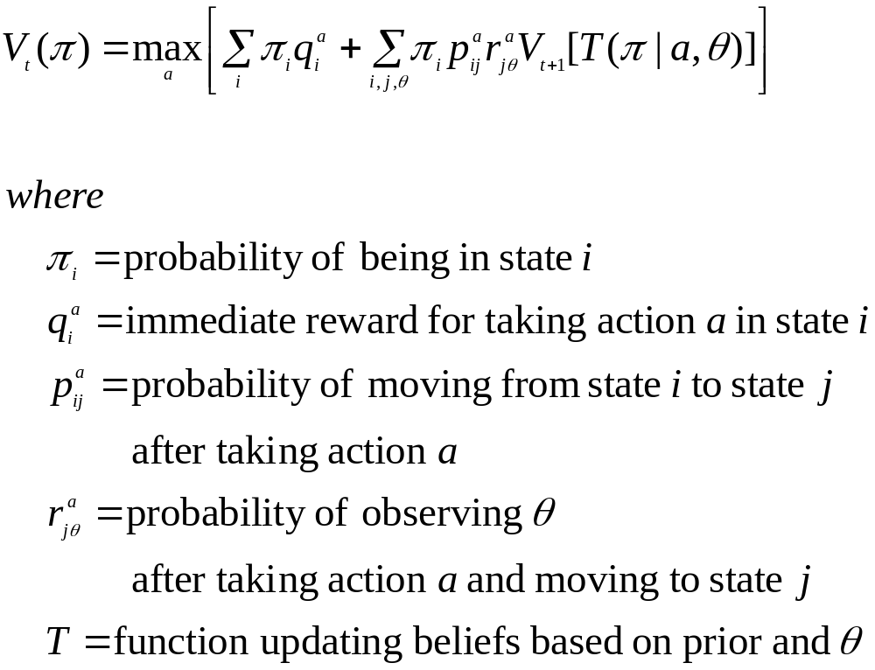
POMDP Value Function

Slide 20
POMDP Example
When is erosion monitoring worth the trouble?
States = {Good Road, Bad Road}
Decisions = {Do Nothing, Monitor, Treat}
Observations = {Good Road, Bad Road}

Slide 21
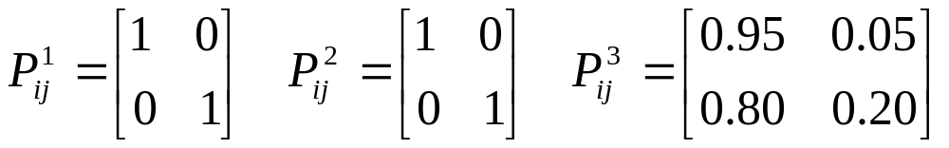
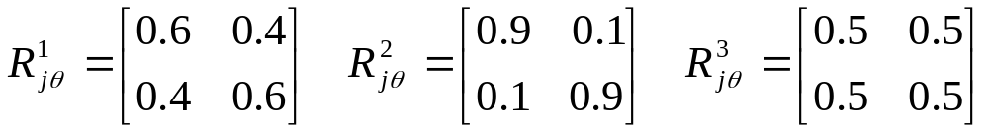
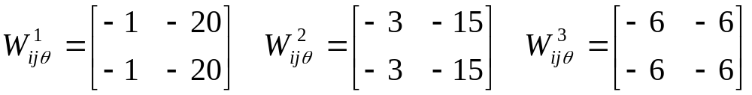
POMDP Example (cont)

Slide 22
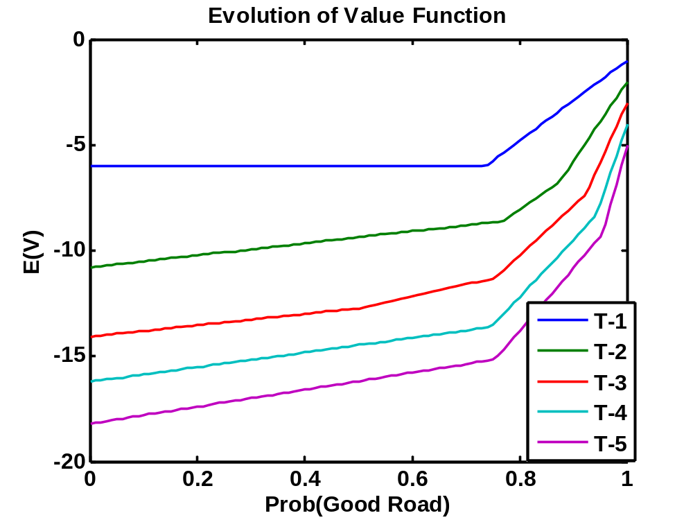
Results for a 5-period problem
Notes:
This shows the evolution of the value function over a 5-period horizon.
In the last decision epoch, monitoring is never part of the solution (why bother?) and you treat the road unless you with there’s at least a 74% probability that it’s a good road—the bad outcome is after all pretty bad.
In T-2, you doing nothing for p1>88%, monitor for p1 on [77,87], and treat below that. Monitoring creeps in b/c you can actually use that info a bit in future. Why does threshold for treatment to stop creep up to 77% from 74% at T-1?
By T-5, you treat up to 70%, monitor on 71-94%, and do nothing above 95%.

Slide 23
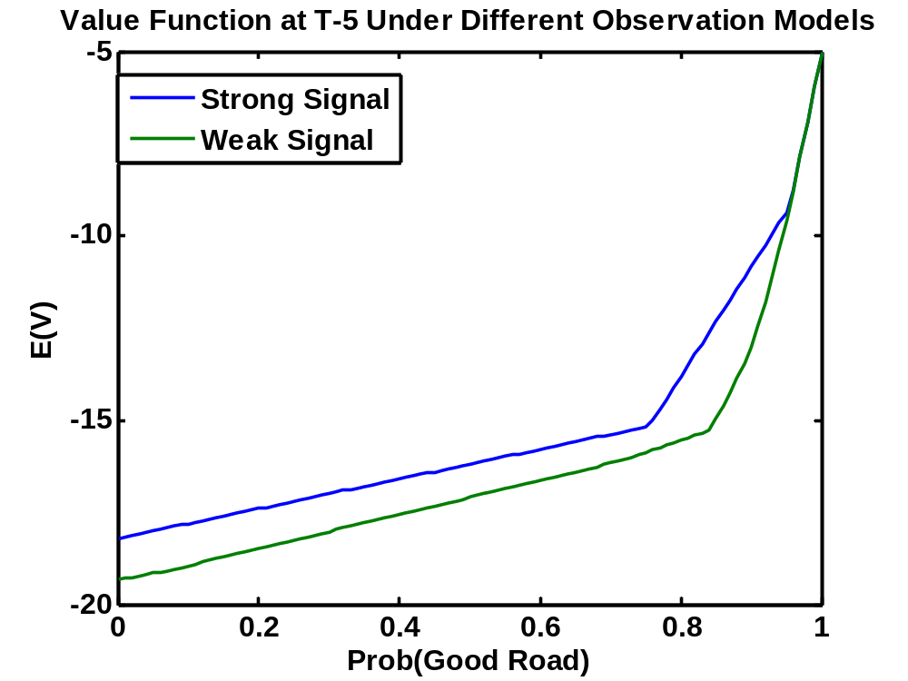
Results (cont)
Notes:
Under weaker signal monitor up from 89% to 94%, versus 71% to 94% under stronger signal. Monitoring is getting crowded out as a strategy.

Slide 24
POMDP Assessment
POMDP is good
  noisy data is everywhere
  monitoring funds are scarce
  applicable to planning and behavioral models
Drawbacks
  computation
  assumes (stochastic) dynamics are known

Slide 25
Decision Models Assessment
Two big technical issues
  parameter uncertainty
  spatial and temporal together
To do: Bayesian DP, neuro-DP, robust portfolio optimization, data envelopment analysis, fuzzy control, decision analysis, sequential hypothesis testing
Models not easily generalizable, need careful development and application with each new problem
Potential bang-for-buck gains are substantial
Notes:
The main conclusion is that it’s going to be difficult at best, and probably just inappropriate, to try to generalize much from this kind of model. If you’re going to try to apply this sort of model you need a different model each time out.

Slide 26
The Egg Model of Ecosystem Management
Decision/Management Models
Ecosystem Models
Organismal & Population Models
Notes:
This picture is one candidate framework for ecosystem management.
Inner circle: Endogenous models of organisms in the system responding to environment and each other.
Next circle: Exogenous factors (climate etc). Picture is not meant to suggest environment is entirely exogenous to organismal/population models, feedbacks are common.
Outer circle: Decision models, which are my focus.
[Digression on social science: People are organisms and many models will need to include them in the inner circle (eg effort diversion). Economics, anthropology, sociology, psychology, all have something to say in the inner circle about homo sapiens, basically in the form of behavioral models of varying levels of formality. Economics may also appear in the outer circle, eg employment impacts or benefit-cost. However, it is entirely possible to have a model that does not include people in the inner circle or economic variables among the decision criteria: if people are not an important part of the ecosystem in question, you can safely ignore them in the organismal & population models; if economic considerations are for whatever reason not part of the objective or constraint set, you can leave them out of the decision/management model. End Digression]
Decision or management models, in the context of ecosystem management, would basically be ecosystem models with objective functions added on.
Clarifying note:
Management decisions may be made in many ways, including without any reference to the ecosystem in question. What I present below are models for systems when an objective function can be defined and the system properties are be well enough characterized to make (costly) model development worthwhile.

